Slide 1
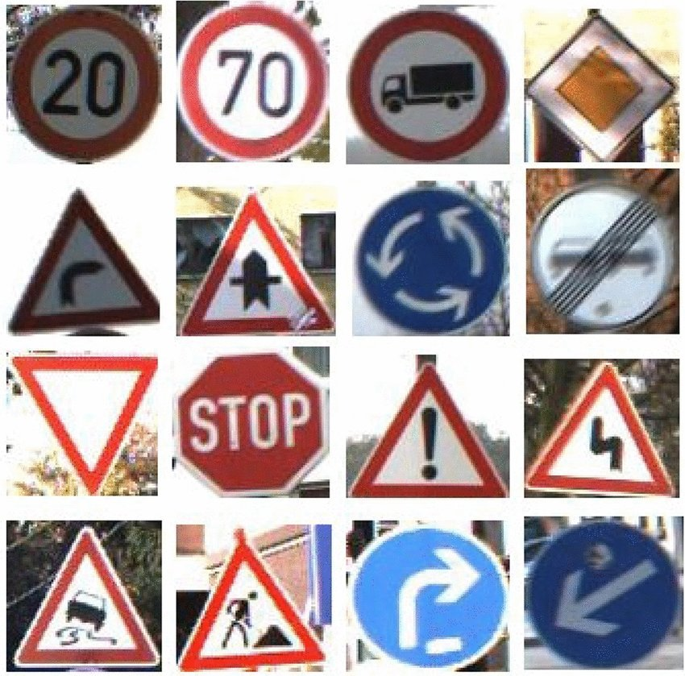
Traffic Sign Recognition Using Convolutional Neural Network
Submitted By:
Anjali Sharma
Nov 19, 2025
Artificial Intelligence
University of Arkansas at Little Rock

Slide 2

Traffic Sign Recognition using GTSRB (German Traffic Sign Recognition Benchmark)
The German Traffic Sign Benchmark is a multi-class, single-image classification challenge held at the International Joint Conference on Neural Networks (IJCNN) 2011.
This benchmark has the following properties:
Single-image, multi-class classification problem
More than 40 classes
More than 50,000 images in total
Large, lifelike database
Physical traffic sign instances are unique within the dataset
(i.e., each real-world traffic sign only occurs once)
Paper Citation: http://dx.doi.org/10.1016/j.neunet.2012.02.016

Slide 3
Real-Time Use Case
Traffic Sign Recognition is used in:
Autonomous vehicles (Tesla, Waymo): Identifying road signs to make driving decisions
ADAS (Advanced Driver Assistance Systems): Alerting drivers to speed limits, stops, and warnings
Smart traffic systems: Detecting sign compliance via cameras

Slide 4
Relevance
This paper is important because it:
Provides a rigorous empirical comparison between humans and machines in a real‐world visual recognition task.
Offers a standardized dataset (GTSRB) that many subsequent works use for traffic sign classification and related vision challenges.
Highlights the importance of benchmark datasets, error analysis, and real‑world conditions (lighting, angles, occlusion) in evaluating vision systems.

Slide 5
Convolutional Neural Network (CNN)
A CNN is a type of deep learning model specifically designed to process grid-like data, such as images.
Key Components:
Convolutional layers: Detect local patterns like edges, shapes, and textures.
Pooling layers: Reduce spatial dimensions and retain important features, making the network more efficient.
Fully connected layers: Combine features to classify the input into categories.

Slide 6
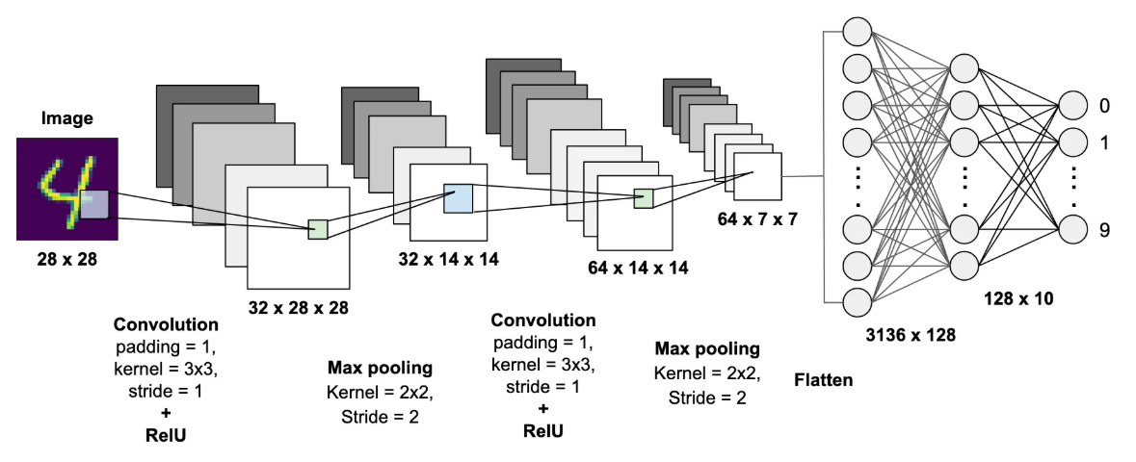

Convolutional Neural Network (CNN)
42
256
43
256
Final Output layer (SoftMax)
Dense

Slide 7
Importance of CNN
Why Do We Need CNNs Instead of Regular Neural Networks?
Traditional neural networks (fully connected/Dense layers):
Can't handle high-dimensional image data well
Flatten the image too early, losing spatial patterns
Have too many parameters and overfit easily
CNNs solve this by:
Looking at small parts of the image at a time (local patterns)
Reusing filters (fewer parameters)
Preserving spatial structure (position matters)

Slide 8
Project Pipeline
Step | Description
1. Dataset | Load & explore GTSRB
2. Preprocessing | Resize, normalize, encode labels
3. Model | Build CNN using TensorFlow/Keras
4. Training | Use Validation and tuning
5. Evaluation | Accuracy, confusion matrix
6. Deployment Idea | Could be converted to web/mobile app

Slide 9
Jupyter Notebook

Slide 10
Thank you

